Slide 1


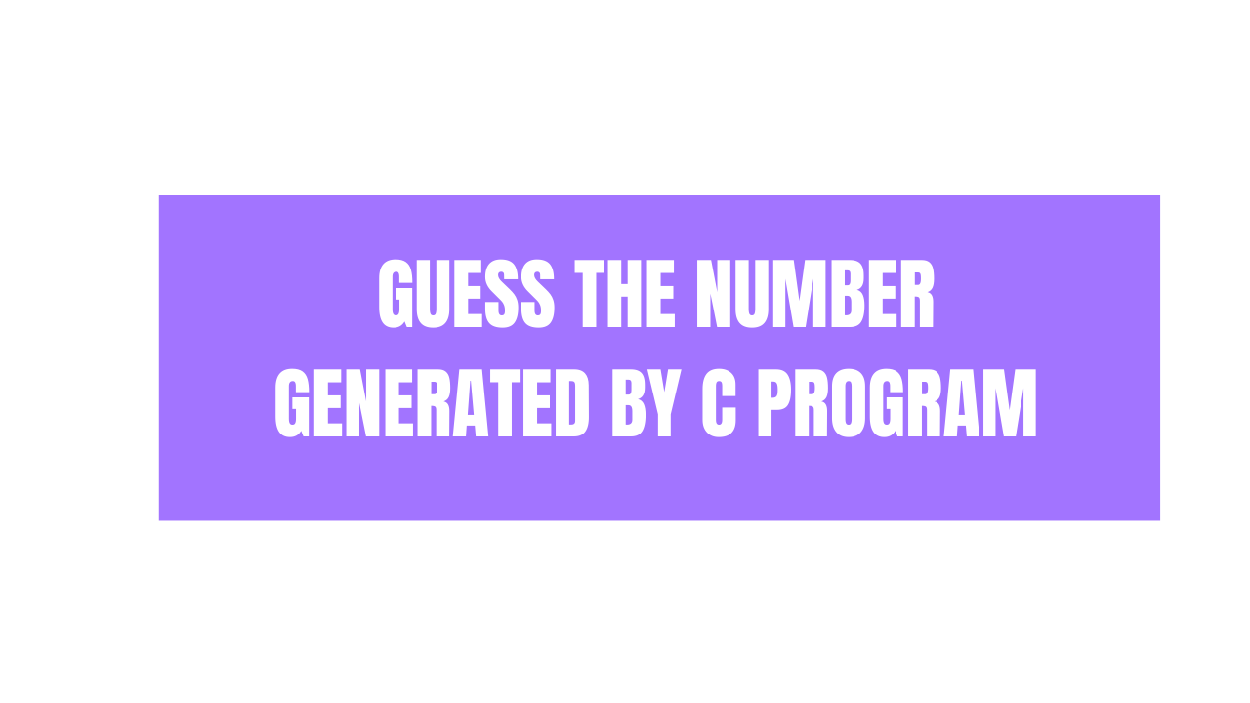

Slide 2
Let’s Jump Into Code

Slide 3
rand() & srand()
This function is used to generate random number in C/C++ language.
This function is define in stdlib.h header file.
This function will generate random number between range of 0 to RAND_MAX.
rand() function will generate fixed number if we don’t use srand() in C/C++ program.
srand(unsigned int seed) function provide the seed value for rand() to generate random number in C/C++ program.
We can ask user to enter seed value when we run the C/C++ program or we can use time() function in C/C++ to get current time from

Slide 4
time()
This library function is used to get time since 1 January 1970 00:00:00.
This function is define in time.h header file.
time(time_t *t) this function will take time_t type pointer as an input and will return seconds value from 1 Jan 1970 00:00:00 which will be type of time_t.
If we pass value as NULL then it will seconds since 1 Jan 1970 00:00:00.

Slide 5
Exercise

Slide 6
Create C program that will generate random number and user needs to guess the number
If user enters the number less then random number notify user to enter larger number.
If user enter the number greater then random number notify user to enter smaller number.
If user enter a correct number notify him/her that he/she wins the game and program will be terminated.
More Advancement
Ask user to enter number range in which program should generate random number.
Ask user to enter number of try he/she can do to guess the number.

Slide 7
Thank you for watching
@ProgrammingMinds

